Slide 1
Kill or Pursue
Group: WASTED
EGN4642
2/12/20

Slide 2
Needs Filtering
Background

Slide 3
Needs Filtering - Insomnia
Need: A way to reduce the incident of insomnia in people
Stakeholders: Individuals(direct/indirect), Companies, Universities, Health/Wellness centers, Center for disease control and prevention(CDC)
Total Market: Global insomnia market is expected to grow at a rate of 4.5% annually during 2017 - 2023. 35% of adults in the US have less than 7 hours of sleep. [1]
Impact: Reducing the incidence of insomnia will increase work productivity, and increase quality of life, as insomnia is often tied with other health conditions. Also lower health care expenditures, as expenditures were 60% higher in the insomnia group relative to non-insomniacs. [2]
Feasibility: It is difficult to identify the cause of insomnia, as it can vary from person to person. Anxiety, depression and stress are commonly tied to insomnia.

Slide 4
Needs Filtering - Plastic Microfiber
Need: A way to prevent plastic microfibers, washed off from synthetic clothes and textiles, from being released to the ocean.
Stakeholders: Mariners, Oceanic scientists and researchers, Government, Doctors and health officials, Conservationist/Environmental activist groups.
Total Market: Marine plastic pollution cost the world around $13 billion in damages or health effects per year. [12] Government and industries stand to save an estimated millions of dollars by taking the environmental actions. Consumers concerned about the environment are willing to spend $15-$150 to be more “eco-friendly” when washing their clothes. [13]
Impact: A subcategory of microplastics is microfibers. These microfibers are mostly coming from our clothes. Of all the world's fiber production, 60% of it is synthetic, meaning made from a plastic material. [8] Every time you wash your clothes or sheets, the fabrics release microfibers. These microfibers travel from the washing machine drains to headwater streams, rivers, lakes, and ocean water. [8]
Feasibility: Internal (inside the washing machine) solutions that catches the microfiber released during the washing cycle. External (filter attached outside the washing machine) solutions that filter out the waste water from the machine for microfibers before it goes to the drain.

Slide 5
Needs filtering- Popcorn ceilings
Need: A way to safely, quickly and efficiently remove popcorn ceilings by yourself to prevent asbestos and dust allergies.
Stakeholders: People in houses with popcorn ceilings, Mesothelioma patients, People with dust allergies, Home renovators, General public, Allergists, Mesothelioma doctors
Target Market: People who are prone to mesothelioma and symptoms of dust allergies who have popcorn ceilings in their homes who also wish to remove them.
78.82 million homes in the US [6]
20 million Americans affected by dust allergies [7]
Impact: By removing popcorn ceilings, people will not be at risk for mesothelioma and will not be victim to the the symptoms of dust allergies.
Feasibility: It may be difficult to fashion a cheap and safe instrument or tool that removes the bumps in a time efficient manner without having the individual breath in the debris.

Slide 6
Needs Filtering - Waste Management
Need: A way to reduce the odor and clutter caused by trash bins/bags lining the streets and sidewalks for those living in compact urban areas
Stakeholders: Community members, State Government, Waste disposal employees, Commuters, Local Government, Environmental regulators
Target Market: Everyone contributes to the total amount of global waste and can benefit from a waste management solution. In the United States the Municipal Solid Waste (MSW) in 2017 was 267.8 million tons, which comes out to 4.51 pounds per person per day. [3,5]
Impact: Without an efficient means to reduce odor and clutter, quality of life will decrease and disease may potentially spread
Feasibility: Possible feasible options include separating compostable waste, a way to remove airspaces in trash bins to enhance packing efficiency

Slide 7
Needs filtering
Evaluation

Slide 8
Market – How many people are affected?
Feasibility – Is there an achievable solution?
Competition – Is anyone doing something similar?
Timeline – How long will product take to reach market?
Revenue Potential – Will solution be monetizable/Profitable?
Motivation – Team Drive and passion for solving unmet need
Needs Filtering

Slide 9
Decision matrix
Criteria | Weight | Insomnia | Plastic Microfibers | Popcorn Ceilings | Waste Management
Market | 5 | 5(25) | 3 (15) | 2 (10) | 5(25)
Feasibility | 3 | 2(6) | 3 (9) | 2 (6) | 3(9)
Competition | 3 | 4(12) | 2 (6) | 5 (15) | 2(6)
Timeline | 4 | 2(8) | 1 (4) | 1 (4) | 3(12)
Revenue Potential | 2 | 4(8) | 1 (2) | 4 (8) | 4(8)
Motivation | 5 | 3(15) | 3 (15) | 4 (20) | 5(25)
Total | Weight - (0-5) Needs - (0-5) | 74 | 51 | 63 | 85
Notes:
Brett and Johnny

Slide 10
Rationales for killing
Criteria | Weight (0-5) | Score (0-5) | Rationale for Killing “Insomnia”
Market | 5 | 5(25) | The market is large. However, each individual may have different causes of insomnia which may be difficult to address.
Feasibility | 3 | 2(6) | There are promising potential solutions to insomnia, however, it is often difficult to identify the cause.
Competition | 3 | 4(12) | There are currently many different types of medications that exist for insomnia.
Timeline | 4 | 2(8) | Typically, solutions in this market have to be tested and FDA approved, which may take years.
Revenue Potential | 2 | 4(8) | Revenue is difficult to predict.
Motivation | 5 | 3(15) | Mediocre- Insomnia is self-treatable, and it will take a lot of effort to come up with an effective solution.
Total | Weight - (0-5) Needs - (0-5) | 74

Slide 11
Rationales for killing
Criteria | Weight (0-5) | Score (0-5) | Rationale for Killing “Plastic Microfibers”
Market | 5 | 3 (15) | Niche market with varying solutions available.
Feasibility | 3 | 3 (9) | Possible solution but hard to design and implement internationally.
Competition | 3 | 2 (6) | Very competitive with varying solutions available.
Timeline | 4 | 1 (4) | Probably take at least one year, maybe longer to design an effective product to compete in the current market.
Revenue Potential | 2 | 1 (2) | Revenue has proven difficult, most governments/ industries are not willing to pay, which only leaves individuals who are unlikely to spend a lot.
Motivation | 5 | 3 (15) | Mild interest in pursuing this need
Total | Weight - (0-5) Needs - (0-5) | 51
Notes:
Johnny

Slide 12
Rationales for killing
Criteria | Weight (1-5) | Score (1-5) | Rationale for Killing “Popcorn Ceilings”
Market | 5 | 2 (10) | There is not as large of a market of interested individuals.
Feasibility | 3 | 2 (6) | As of now, there is not a DIY method, so it may be difficult.
Competition | 3 | 5 (15) | There is not a plethora of products for popcorn ceiling removal.
Timeline | 4 | 1 (4) | This project may take many months to come to fruition.
Revenue Potential | 2 | 4 (10) | This project has the potential to make a decent revenue.
Motivation | 5 | 4 (20) | As a group, we find this project very interesting.
Total |  | 65

Slide 13
Rationales for pursuing
Criteria | Weight (1-5) | Score (1-5) | Rationale for Pursuing “Waste Management”
Market | 5 | 5(25) | Large and growing market size without much competition
Feasibility | 3 | 3(9) | We envision multiple potential solutions and target demographics
Competition | 3 | 2(6) | There aren’t many widely adopted solutions to this issue
Timeline | 4 | 3(12) | This will be likely feasible within our time constraints depending on the solution
Revenue Potential | 2 | 4(8) | With a large market and common need, there is a great potential for revenue and profit
Motivation | 5 | 5(25) | This issue impacts all of our group members on a regular basis and we’re interested in solving it
Total |  | 85
Notes:
Brett

Slide 14
Rationales for pursuing waste management
Market
Total market is large, everyone contributes to waste. Private homes, industrial and city settings could benefit from a solution.
Feasibility
Through brainstorming, and creative thinking, we are confident that we could come up with a solution that is feasible and decreases the severity of this issue.
Competition
Currently, there aren't any widespread solutions that are efficient in reducing clutter and odor
Motivation
As a group, we are highly interested in pursuing this need, as we all contribute significantly to waste and experience this issue daily in our personal lives.

Slide 15
Final need statement
“There is a need to decrease odor from trash in compact urban areas.”

Slide 16
Background

Slide 17
Background
In urban environments it is common to see trash bins and bags line the street, which can negatively impact quality of life for those living or commuting in the community.
Overflowing trash bins cause foul odors and can attract pests and rodents.
In many urban areas, particularly those in older cities where the streets may not be very wide, having trash bins lining the street’s edge can add to traffic congestion.
Americans produce around 254 million tons of trash each year, and as a result waste management is a $4 billion industry in the United States.[3]

Slide 18
Background
Municipal Solid Waste (MSW) refers to the amount of trash or various items in pounds, that consumers throw away.
According to the EPA, in the United States the MSW in 2017 was 267.8 million tons, which comes out to 4.51 pounds per person per day. [3]
This rate of 4.51 pounds per person per day represents a steady decrease from the peak in 2000 of 4.74 pounds [4] , but factoring in population growth, the market is growing in the United States.
The MSW that represents trash sent to landfills combined with that which is recycled accounts for approximately 233 million tons, or 87.3% of all MSW. Trash and recycling bins are the two types of bins that this issue revolves around.[5]

Slide 19
Background
Currently, this problem remains largely unsolved. While the primary focus is on trash bins and bags causing issues in cities within the United States, it should be noted that trash collection and disposal is a much bigger issue in developing countries. Some cities in these countries spend 20-50% of their budgets on waste management[3].
Since 2000, the World Bank has contributed close to $4.5 billion to assist in the funding of over 325 solid waste programs globally[3].
These facts prove there is an additional large market if the solution posed would reduce those costs to local governments or citizens.

Slide 20
Stakeholder Analysis

Slide 21
Stakeholder List
Waste disposal employees
Waste Management, Inc.
State & Local Governments
Pedestrians/Commuters
Environmental regulators
Community members
Homeless
Safety professionals
Residents
Notes:
Shaila will finish

Slide 22
Stakeholder matrix
Stakeholder Group | Pains | Gains
Waste Disposal Employees | New system or product to accommodate | Easier, more efficient tasks
State/Local Government | Upfront costs to implement changes, maintenance costs | Long term cost savings, more efficient system of waste disposal
Pedestrians/Commuters | Increased taxes if implemented local government | Easier to navigate cramped city streets
Environmental Regulators | Potential cost and time to test, approve and regulate | Improvement to health/environment of urban areas.
Community Members/Residents | Direct cost to consumers, increased taxes if implemented by local gov. | Less eyesore of trash bins/bags, less odor when walking on street

Slide 23
Stakeholder matrix
Stakeholder Group | Pains | Gains
Homeless | They may not have the means to financially contribute towards this project. | They will not smell the trash and will not see any of the bugs/rodents that come with smelly trash.
Safety Professionals | May have to approve of possible solutions | Less time inspecting cafeterias/ food courts
Restaurants/Food vendors | Extra costs on waste, increased taxes if implemented by local gov. | Customers will be more satisfied. More likely to pass health inspections
Grocers | Extra steps may have to be implemented for waste disposal, increased taxes if implemented by local gov. | Minimize unwanted pests

Slide 24
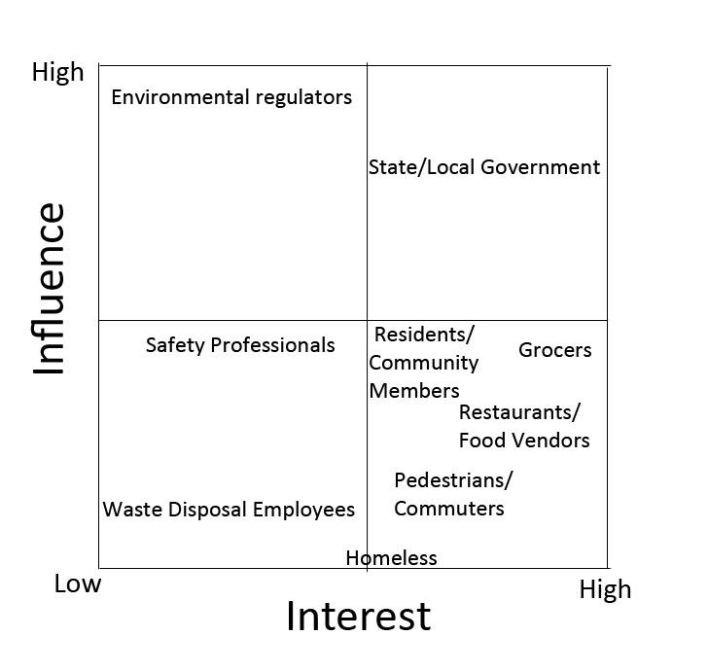
Stakeholder mapping

Slide 25
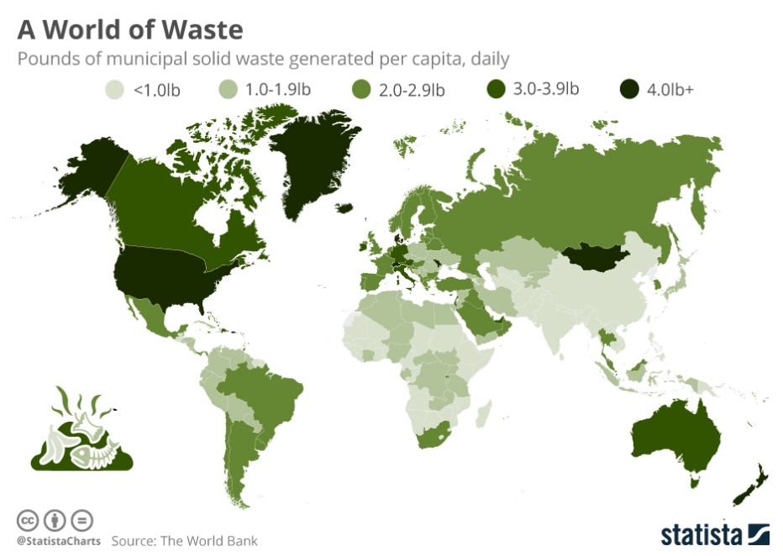
Stakeholder statistics
[4]

Slide 26
Target market
GSA: Solid Waste Management
State Environmental Agency for Waste
State Legislators
52.5% of solid waste generated in the U.S. was disposed of in 1,738 landfills. [9]
Private/Public Waste Management Companies
Municipal Solid Waste Management
~20,000 companies within the waste industry in the US.[10]
Residential Communities
Distribution/Retail Centers
Notes:
Johnny

Slide 27
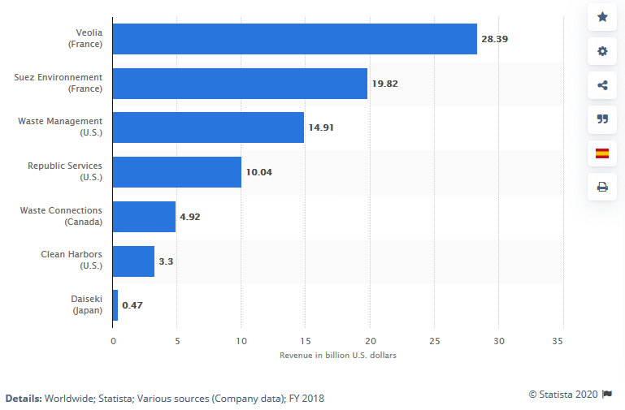
Total market/impact
Potential consumers would be, mainly, waste management companies or government agency tasked with handling waste.
Globally, waste control generates about $400 billion in revenue annually. [11]
Despite the waste industry being perceived as slow moving, investment into digitalizing the waste management industry is expected to grow.
The US waste management industry includes about 25,000 establishments (single-location and multi-location companies) with combined annual revenue of about $95 billion. [11]
Notes:
Johnny

Slide 28
Market segments
The overall market is agencies/companies that manages of waste at a large scale. The mass market approach would not be suitable due to the different needs,factors, and wants of the various locations.
A segmented market approach was taken due to stakeholders having significant different needs and preferences. Examples:
Stakeholder need- Identifying the similar needs and wants of the various stakeholders, it aligns us to better serve their needs.
Value- Stakeholders who seek to minimize the environmental impact of their waste.
Price Sensitivity- Wants a cheap solution that will last a long time. (Cheap in respect to their overall budget.)
Lifestyle- Prefer not to disrupt current lifestyle of customers or the adjustments should make the process easier for employees.
Stakeholder Preferences- Wants a product to be affordable and simple to implemented, should not disrupt current method of doing things.
Notes:
Johnny

Slide 29
Needs Specification

Slide 30
Needs specifications
Customer Comment | Translated Need
“It is an issue but not something I’d spend a whole lot of money on.” | Solution/product needs to be low cost (< $ 20). Based on a google form we conducted with sample size of 33, over 2/3 of respondents said the solution should be $20 or less
“What’s the point of just me buying a new kind of trash bin or something (if the point is to reduce street clutter)?” | Community level implementation of the solution may be ideal
“I wouldn’t use it if it’s too complex.” | The solution must not have a large amount of steps or any complex processes for the user to learn
“If it’s a new kind of garbage can it should be light enough to carry (to the street).” | Solution must be lightweight and manageable for all individuals
“I’d be less likely to use whatever it is if it gives less space than a normal trash can.” | Solution must not substantially deviate from the volume of space in a normal trash bin
“A lot of times trash bags rip open on the street (because they’re overfull).” | Solution must be durable and withstand poor or rough treatment
Notes:
Brett

Slide 31
Competitive Landscape
Current solutions

Slide 32
Current solutions
Odor Absorbing Trash Bags - Many trash bag producers offer odor reducing or absorbing bags
Pros: No habit changes - consumer just uses these bags as they would normally
Cons: More expensive than standard trash bags
Trash Bin Deodorizers - There are products on the market used to deodorize trash bins
Pros: Mitigates the smell issue
Cons: Only effective when bin owner decides to use it
Local Community Regulations - Many local communities have rules about where and when one can put their trash
Pros: Prevents trash from being on the street constantly
Cons: Not heavily enforceable, doesn’t prevent odor problem in the time and place trash is permitted to be
Waste Reduction Advertisement Campaigns - Some governments have implemented advertising to encourage citizens to reduce the amount of waste they produce
Pros: Helps cut off odor issue at its source by encouraging people to produce less waste
Cons: Effectiveness is unknown, not strongly advertised
Composting - Some consumers choose to compost much of their waste
Pros: Less waste makes it to the trash can and thus onto the street
Cons: Simply relocates the smell issue, may attract animals/pests
Notes:
Brett

Slide 33
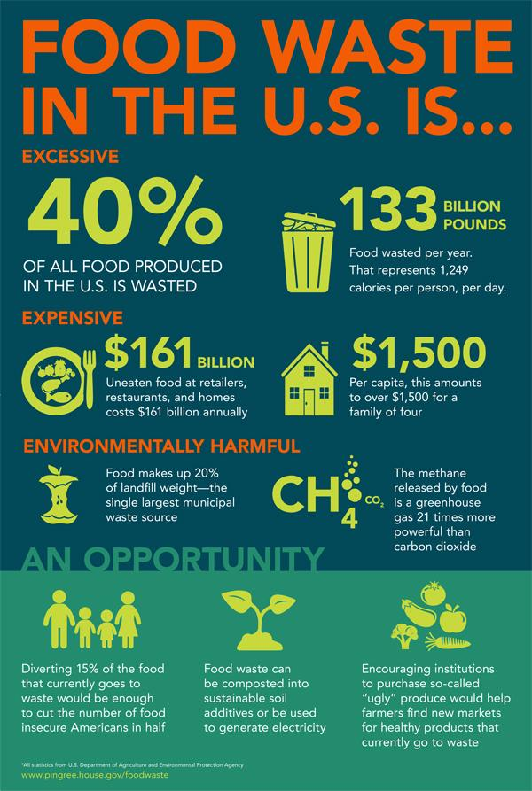
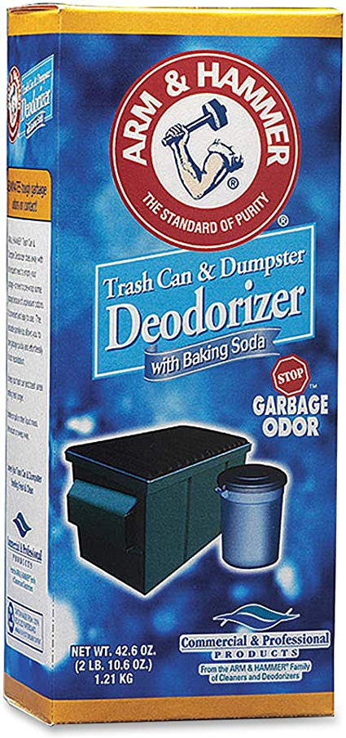
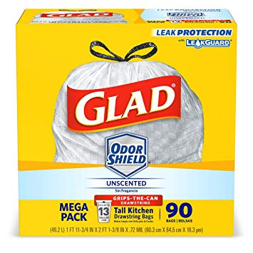
Current solutions
Trash Bin Deodorizer Products
Arm & Hammer
Rubbermaid
Local Community Regulations
Waste Reduction Advertisement Campaigns
Composting
Odor Absorbing Trash Bags
Hefty
Glad
Notes:
Brett

Slide 34
Current solutions analysis Matrix
Solution | Low Cost (< $20) | Easy to Use | Reduces Odor | Reduces trash on street | Community Level Implementation
Arm & Hammer Deodorizer | ✅ | ✅ | ✅ | ☒ | ☒
Rubbermaid Deodorizer | ✅ | ✅ | ✅ | ☒ | ☒
Community Regulations | ☒ | - | - | ✅ | ✅
Waste Reduction Ads | ☒ | - | - | - | ✅
Composting | - | ☒ | ☒ | ✅ | ☒
Hefty Odor Absorbing Trash Bags | ✅ | ✅ | ✅ | ☒ | ☒
Glad Odor Shield Trash Bags | ✅ | ✅ | ✅ | ☒ | ☒
Notes:
Brett

Slide 35
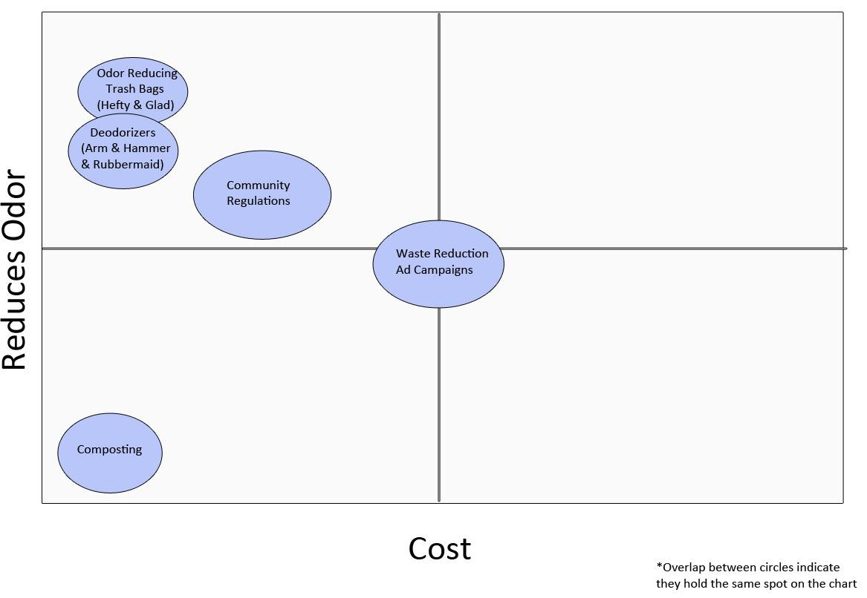
White Space Analysis
Notes:
Brett

Slide 36
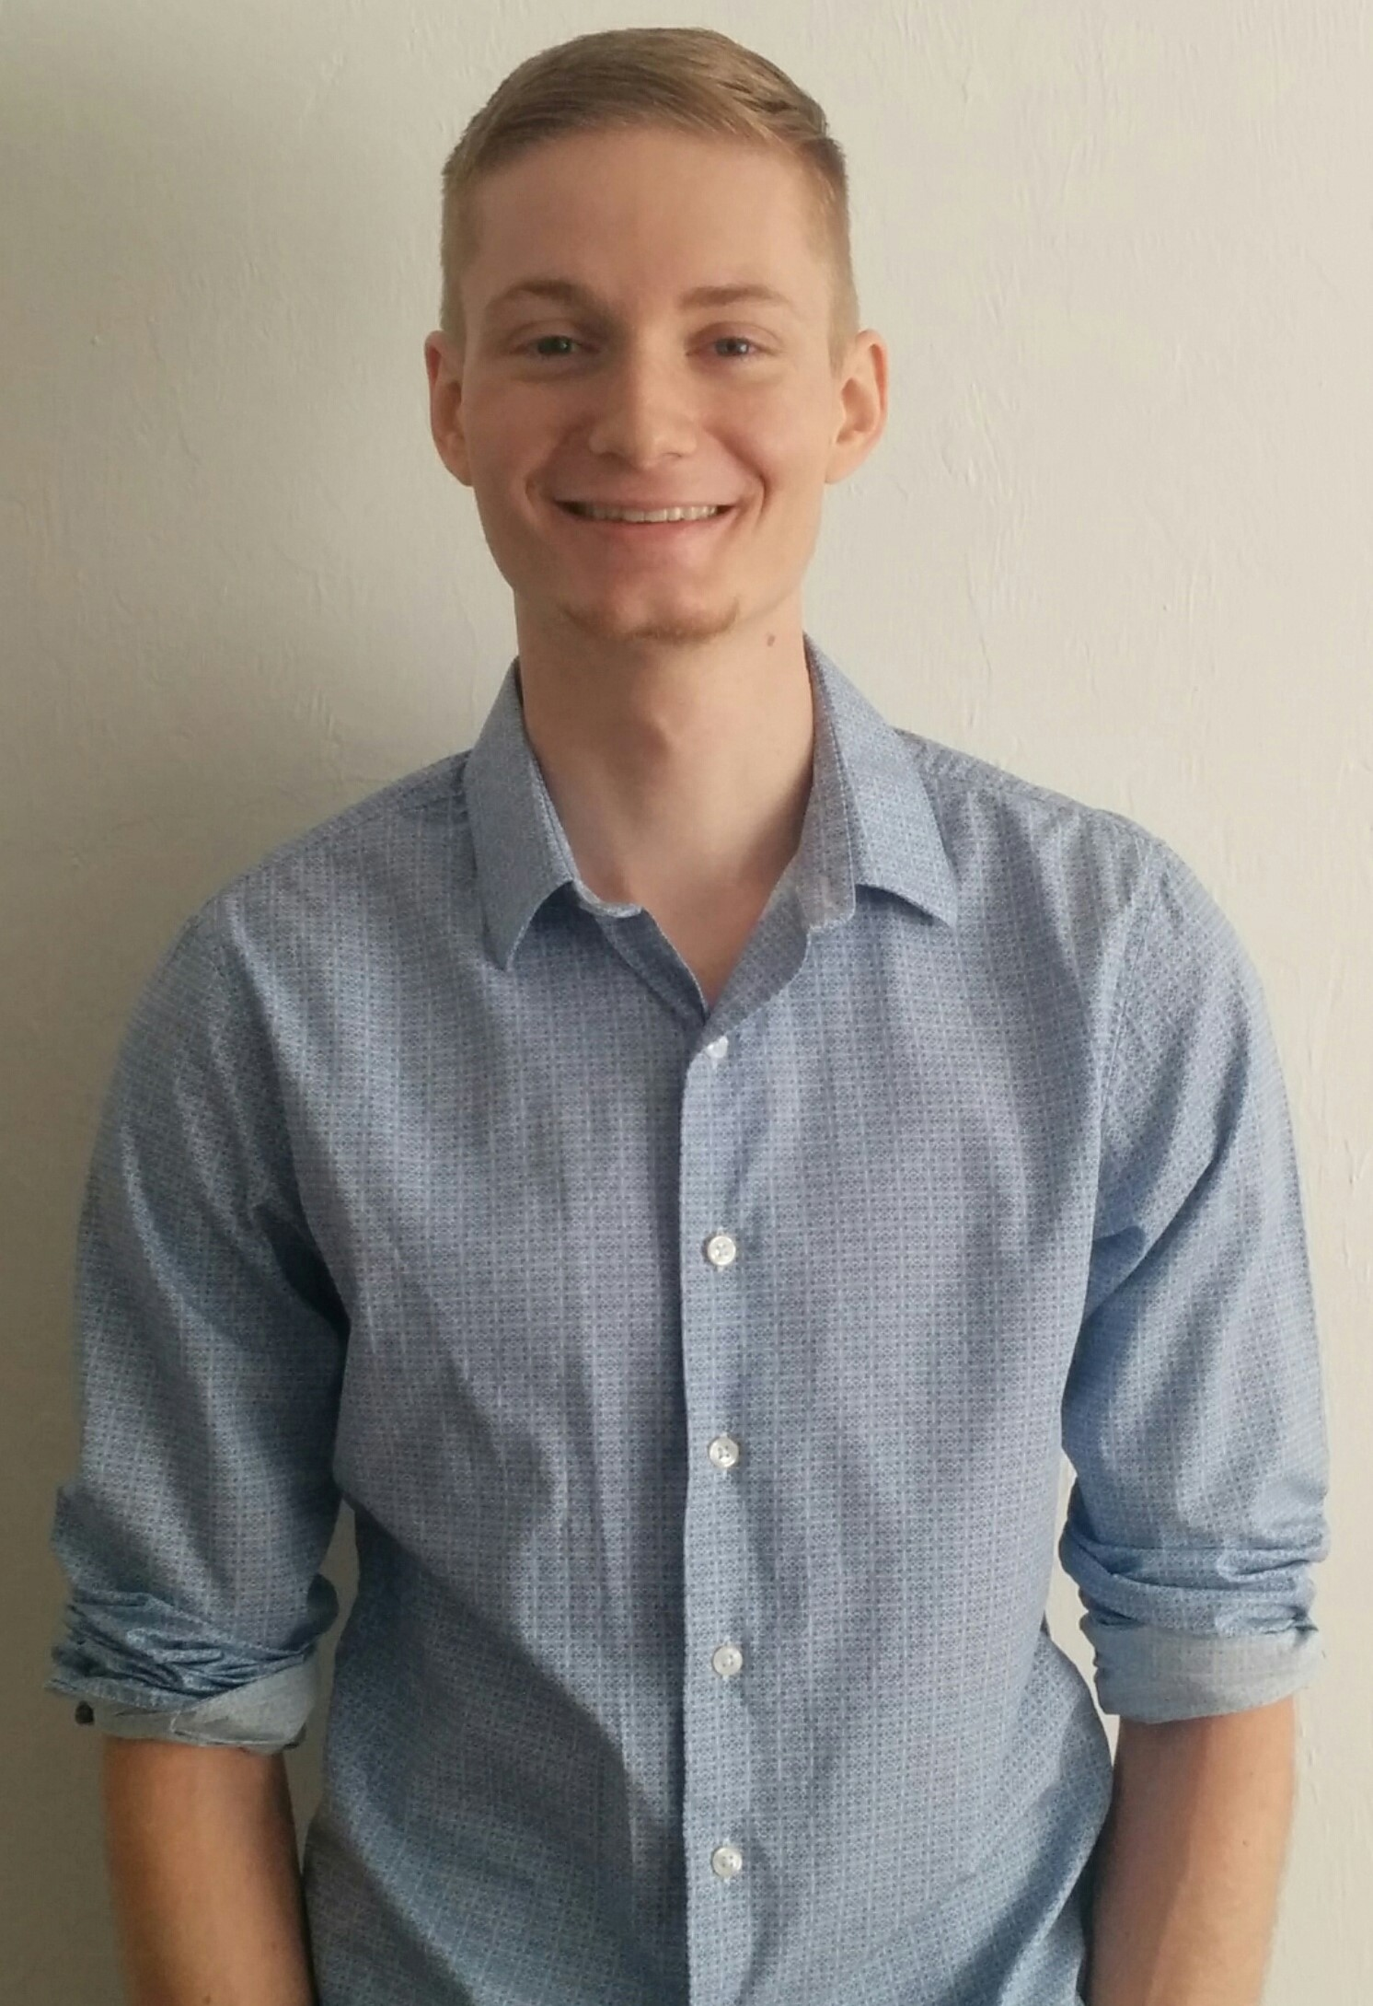

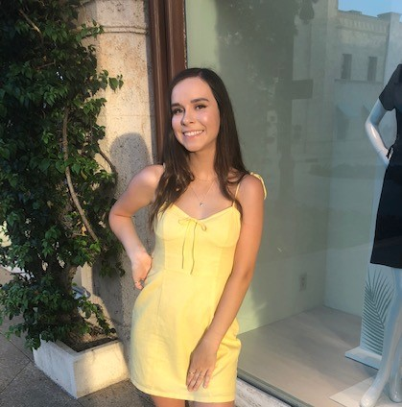


Personnel
Brett Chevalier
Undergraduate
Bachelor’s
Computer Science
Johnny Li
Undergraduate
Bachelor’s
Computer
Engineering
Charles Lazimi
Graduate
Masters
Biomedical Engineering
Annalina Becker
Undergraduate
Bachelor’s
Electrical
Engineering
Jaeyong Sin
Undergraduate
Bachelor’s
Computer Science
Shaila Patel
Undergraduate
Bachelor’s
Computer Science
Notes:
All of us - name, major, picture

Slide 37
References
[1] “CDC - Data and Statistics - Sleep and Sleep Disorders.” Centers for Disease Control and Prevention, Centers for Disease Control and Prevention, 2 May 2017, www.cdc.gov/sleep/data_statistics.html.
[2] “Insomnia Market Trends, Size, Share and Analysis By 2023: MRFR.” Insomnia Market Trends, Size, Share and Analysis By 2023 | MRFR, www.marketresearchfuture.com/reports/insomnia-market-545.
[3]“The World's Trash Crisis, and Why Many Americans Are Oblivious.” Los Angeles Times, Los Angeles Times, 22 Apr. 2016, www.latimes.com/world/global-development/la-fg-global-trash-20160422-20160421-snap-htmlstory.html.
[4] “50 Recycling & Trash Statistics That Will Make You Think Twice About Your Trash.” Rubicon Global: Waste, Recycling, and Smart City Technology Company, 12 Dec. 2019, www.rubiconglobal.com/blog/statistics-trash-recycling/.
[5] “National Overview: Facts and Figures on Materials, Wastes and Recycling.” EPA, Environmental Protection Agency, 3 Dec. 2019, www.epa.gov/facts-and-figures-about-materials-waste-and-recycling/national-overview-facts-and-figures-materials.
[6] Rudden, Jennifer. “Numbrt of Houses in U.S.” Statista, Statistica, 17 July 2019, www.statista.com/statistics/240267/number-of-housing-units-in-the-united-states/.
[7]“Dust Mite Allergy.” Asthma and Allergy Foundation of America New England Chapter, 2020, asthmaandallergies.org/asthma-allergies/dust-mite-allergy/.
[8] Andrea d. Steffen. “This Is The First Ever Microplastics Filter For Washing Machines!” Intelligent Living, NPR, 12 Sept. 2019, www.intelligentliving.co/microplastics-filter-washing-machines/.
[9] “Municipal Solid Waste Factsheet.” Municipal Solid Waste Factsheet | Center for Sustainable Systems, css.umich.edu/factsheets/municipal-solid-waste-factsheet.
[10] Gridwaste.com, www.gridwaste.com/news/2014/8/20/10l92d52vzaw1zdsf0znubdqpttq7k.
[11] “Waste Management Services Industry Profile.” First Research, www.firstresearch.com/Industry-Research/Waste-Management-Services.html.
[12] Amadeo, Kimberly. “The Rising Costs of Pollution and What Can Be Done About It.” The Balance, www.thebalance.com/pollution-facts-economic-effect-4161042.
[13] Curtin, Melanie. “73 Percent of Millennials Are Willing to Spend More Money on This 1 Type of Product.” Inc.com, Inc., 30 Mar. 2018, www.inc.com/melanie-curtin/73-percent-of-millennials-are-willing-to-spend-more-money-on-this-1-type-of-product.html.
Notes:
All of us

